Slide 1
EEG Paradigms
Course Instructor
Dr. Annushree Bablani
Acknowledgments: Dr Sreeja SR

Slide 2
Direct (noninvasive) interfaces in EEG
An event-related potential (ERP) is any measured brain response that is directly the result of a thought or perception. More formally, it is any stereotyped electrophysiological response to an internal or external stimulus.
Direct Interfaces via EEG
VEP – Visual Evoked Potential
AEP – Auditory Evoked Potential
SSVEP – Steady-State Visual Evoked Potential
P300 – ERP elicited by infrequent, task-relevant stimuli.
ERS/ERD – Event related synchronization/desynchronization
SCP – Slow cortical potentials

Slide 3
Categorization of EEG based BCI paradigms
Evoked (Endogenous / Asynchronous)
Subject must pay attention for a certain time to external cues (e.g. flashes, sounds, etc.)
Cue-based
Spontaneous (Exogenous / Synchronous)
No continuous attention to specific stimulus is necessary
User-driven

Slide 4
Categorization of EEG based BCI paradigms
ERD | Spontaneous
P300 | Evoked
SSEP/AEP/VEP | Evoked
SCP | Spontaneous

Slide 5
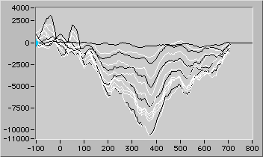
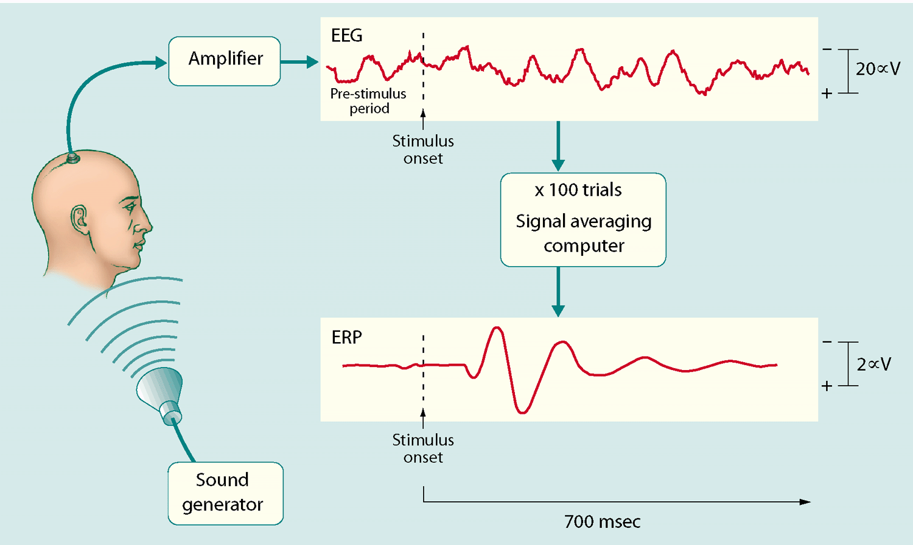
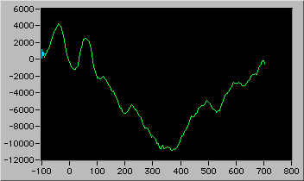
Event Related Potentials (ERP)
Averaging of trials following a stimulus

Slide 6
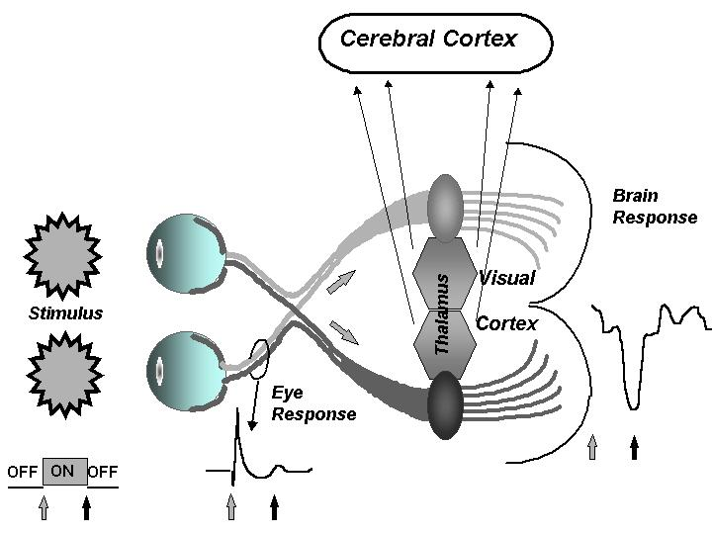
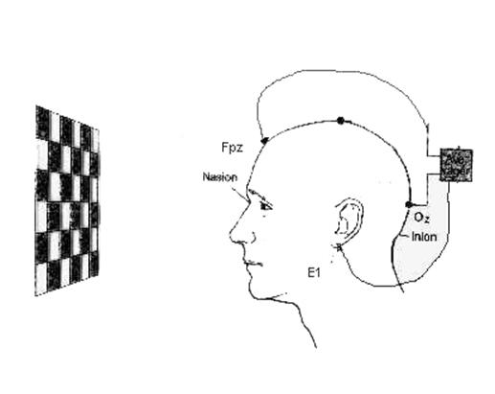
Visual Evoked Potential (VEP)
Caused by Visual Stimulus
Occurs with flashing lights (3-5 Hz)
Have been used to monitor function during surgery for lesions involving the pituitary gland, optic nerve.
Application:

Slide 7
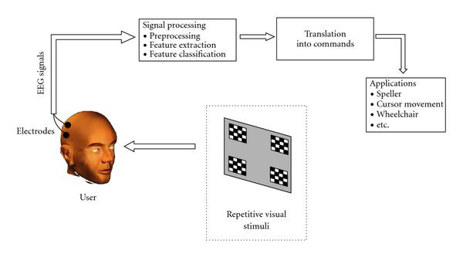
Steady-State Visual Evoked Potential (SSVEP)
SSVEP are signals that are natural responses to visual stimulation at specific frequencies. When the retina is excited by a visual stimulus ranging from 3.5 Hz to 75 Hz, the brain generates electrical activity at the same (or multiples of) frequency of the visual stimulus.
Excellent signal-to-noise ratio and relative immunity to artifacts.
Applications:
SSVEP-controlled robots (Boston University)
User-friendly interface

Slide 8
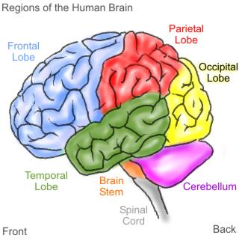
P300
P300 is thought to reflect processes involved in stimulus evaluation or categorization.
It is usually elicited using the oddball paradigm in which low-probability target items are inter-mixed with high-probability non-target (or "standard") items.
Results in a positive curve on EEG after 300ms.
Strongest signal at parental lobe.
6x6 matrix of symbols
Subject concentrates on a symbol (i.e. cell)
Each row and column flashes twice
i.e. 2 target flashes vs. 10 non-target flashes
random order
for very short time (e.g. 100 ms)

Slide 9
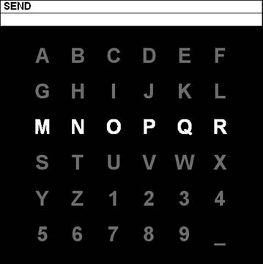
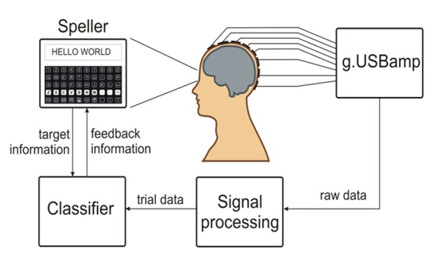
P300
(Farwell and Donchin 1988)
95% accuracy at 1 character per 26s

Slide 10
ERS/ERD
Event-related desynchronization (ERD) and event-related synchronization (ERS) is the change of signal's power occurring in a given band, relative to a reference interval.
People have naturally occurring brain rhythms over areas of the brain concerned with touch and movement. When people imagine moving, these brain rhythms first become weaker, then stronger. These two changes are called ERD and ERS, respectively.
ERS
oscillatory power increase
associated with activity decrease
ERD
oscillatory power decrease
associated with activity increase

Slide 11
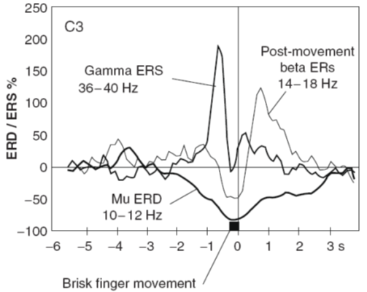
ERS/ERD
The imagination of either a left or right hand movement results in:
An amplitude attenuation (Event-Related Desynchronization (ERD)) of μ (8-12Hz) and central beta EEG-rhythms (13-30Hz) at the contralateral sensorial motor representation area and,
in some cases, in an amplitude increase (Event-Related Synchronization (ERS)) within the γ-band (30-40Hz) at the ipsi-lateral hemisphere(6).
EEG recorded from C3 electrode.

Slide 12
ERS/ERD (4)
Typical Theta response
Apha response
Theta
Amplitude
ERS
Alpha
Amplitude
ERD
Time
Time
Pre-Stimulus
Post-Stimulus
Pre-Stimulus
Post-Stimulus
Stimulus
Stimulus

Slide 13
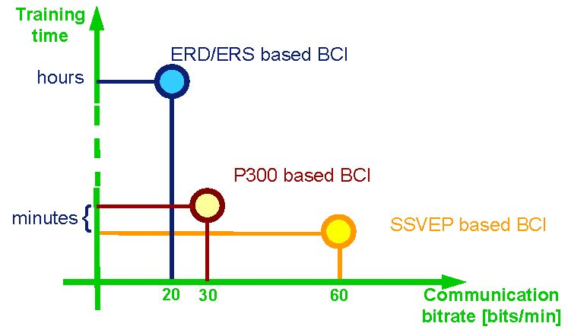
Communication Issues
Typical training time versus communication bitrate for the three main types of noninvasive EEG based BCIs.

Slide 14
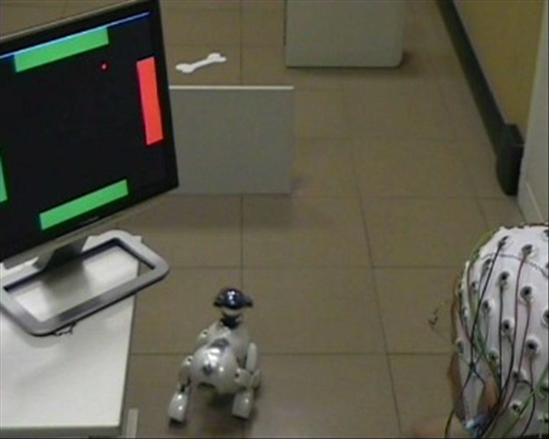
BCI Applications
BCI – operated robot

Slide 15
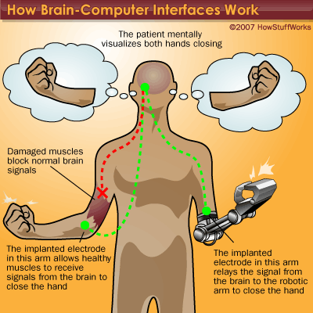
BCI Applications

Slide 16
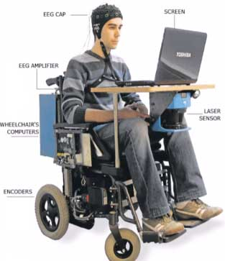
BCI Applications

Slide 17
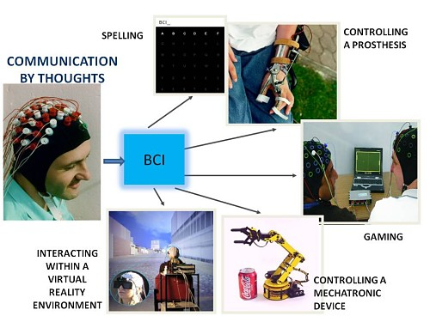
BCI Applications

Slide 18
Thank you!

